Slide 1
Credit default prediction
Guanghong Yi

Slide 2
background and the story
2006, Taiwan Financial Supervisory Commission
$4.93 billion worth of bad loans
$3.49 billion from credit card loans
$1.44 billion from cash card loans
Taiwan Credit Crisis
Reason: Give out too much credit in order to stimulate business

Slide 3
PRIMARY GOALS
Predict default payment next month

Slide 4
About dataset
Payment data given by an important bank in Taiwan(a cash and credit card issuer) from April 2005 to September 2005
Amount: 30000
Categories:
ID
Limit Balance
Sex
Education
Marriage
Age
Repayment Status (from April to September 2005)
Amount of bill statement (from April to September 2005)
Amount of previous payment (from April to September 2005)
Default payment next month

Slide 5
Dataset
 | 1 | 2 | 3 | 4 | 5
ID | 1 | 2 | 3 | 4 | 5
LIMIT_BAL | 20000 | 120000 | 90000 | 50000 | 50000
SEX | 2 | 2 | 2 | 2 | 1
EDUCATION | 2 | 2 | 2 | 2 | 2
MARRIAGE | 1 | 2 | 2 | 1 | 1
AGE | 24 | 26 | 34 | 37 | 57
PAY | -2 | 2 | 0 | 0 | 0
BILL_LIMIT | 0 | 3261 | 15549 | 29547 | 19131
PAY_AMT | 0 | 2000 | 5000 | 1000 | 679
DEFAULT | 1 | 1 | 0 | 0 | 0

Slide 6
Descriptive analysis

Slide 7
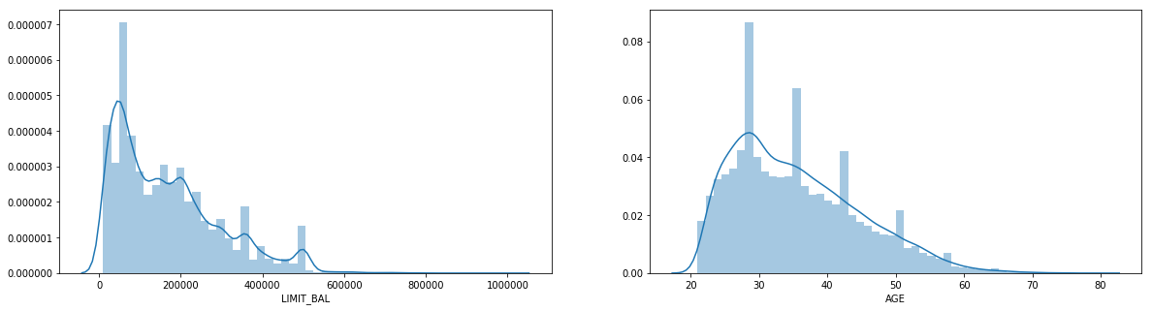
Descriptive analysis

Slide 8
Descriptive analysis

Slide 9
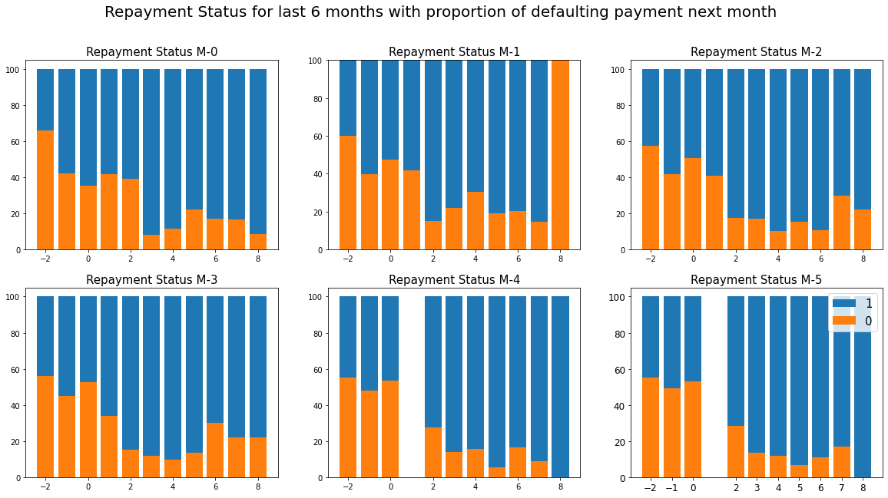
Descriptive analysis

Slide 10
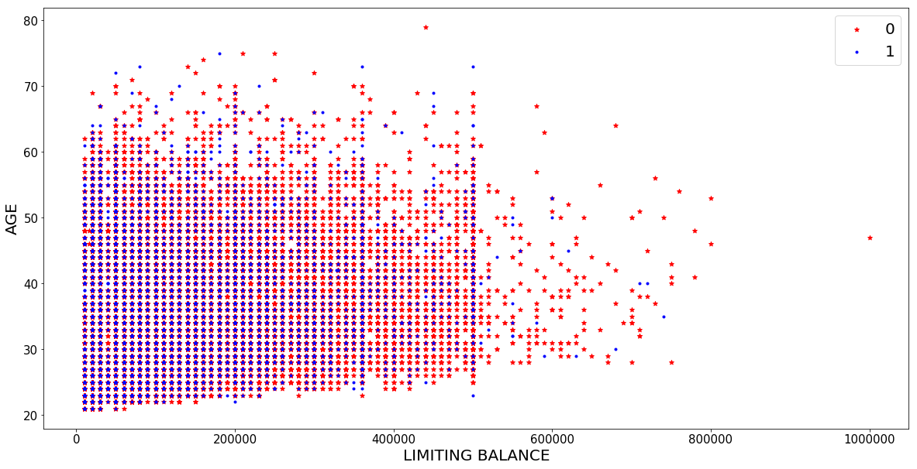
Descriptive analysis

Slide 11
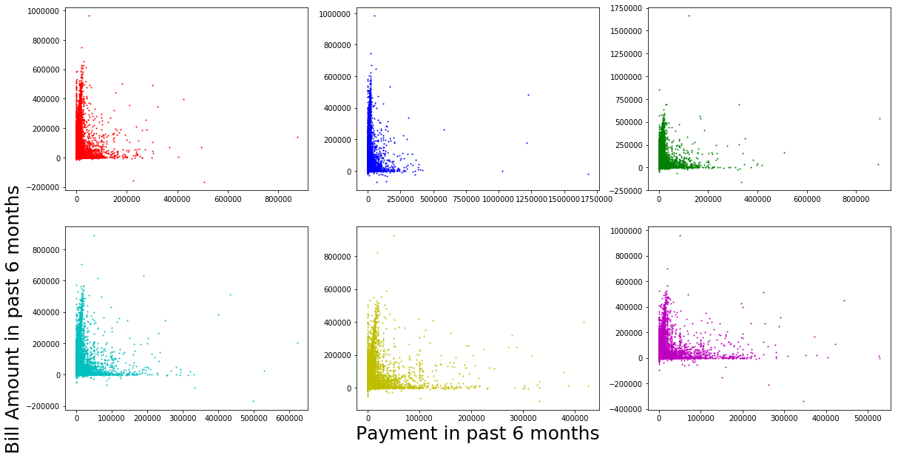
Descriptive analysis

Slide 12
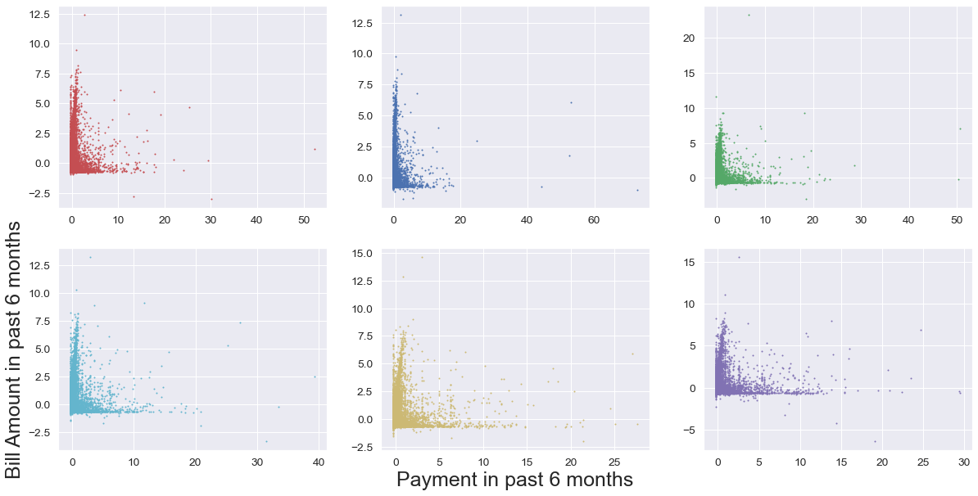
Standardization
Feature Scaling:
Scalar = StandardScaler()
X_train_scale = scaler.fit_transform(X_train)
X_test_scale = scaler.transform(X_test)
X_train = pd.Dataframe(X_train_scale, columns = X_train.columns)
X_test = pd.Dataframe(X_test_scale, columns = X_test.columns)

Slide 13
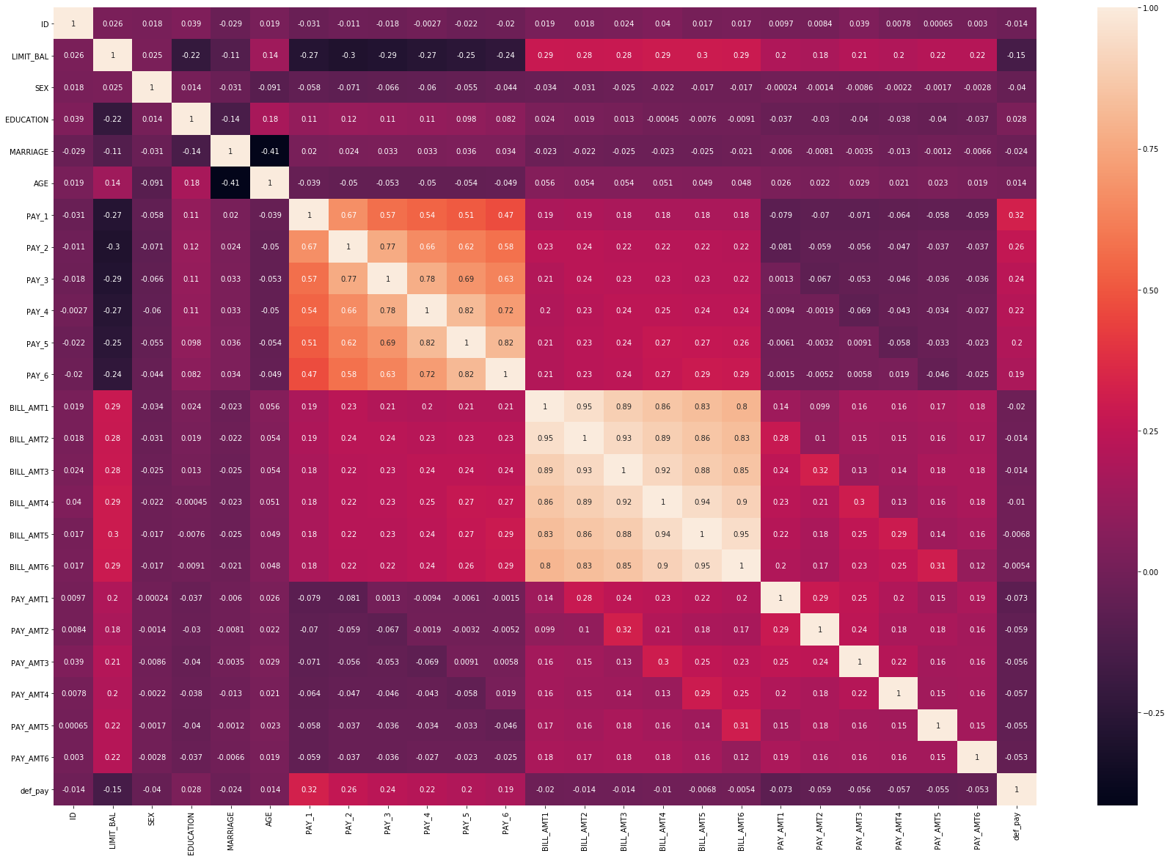
Correlation matrix

Slide 14
algorithms
Logistic Regression
K Neighborhood
Random Forest

Slide 15
Logistic regression
df_X = defaulters.drop(['default payment next month','AGE_BIN'], axis=1)
df_y = defaulters['default payment next month']
Precision Recall F1-Score Support
0 1.00 0.78 0.88 14950
1 0.01 0.62 0.02 50
Accuracy 0.78 15000
Macro average 0.5 0.70 0.45 15000
Weighted average 1.0 0.78 0.87 15000
Accuracy Score for model: 0.780166666666667
Confusion Matrix:
11615 | 3335
19 | 31

Slide 16
Logistic regression
df_X = defaulters. [[‘SEX’ , ‘MARRIAGE’ , ‘AGE’ , ‘BILL_AMT1’ , ‘Education’ , ‘PAY_1’]]
df_y = defaulters['default payment next month']
Precision Recall F1-Score Support
0 0.97 0.82 0.89 13736
1 0.26 0.69 0.38 1264
Accuracy 0.79 15000
Macro average 0.55 0.39 0.54 15000
Weighted average 0.95 0.78 0.86 15000
Accuracy Score for model: 0.8180
Confusion Matrix:
11288 | 2448
390 | 874

Slide 17
K neighborhoods
df_X = defaulters. [[‘SEX’ , ‘MARRIAGE’ , ‘AGE’ , ‘BILL_AMT1’ , ‘Education’ , ‘PAY_1’]]
df_y = defaulters['default payment next month']
Precision Recall F1-Score Support
0 0.78 0.92 0.85 11678
1 0.26 0.10 0.14 3322
Accuracy 0.74 15000
Macro average 0.67 0.63 0.64 15000
Weighted average 0.76 0.78 0.76 15000
Accuracy Score for model: 0.7392
Confusion Matrix:
10769 | 909
3003 | 319

Slide 18
Random forest
df_X = defaulters. [[‘SEX’ , ‘MARRIAGE’ , ‘AGE’ , ‘BILL_AMT1’ , ‘Education’ , ‘PAY_1’]]
df_y = defaulters['default payment next month']
Precision Recall F1-Score Support
0 0.83 0.89 0.86 11678
1 0.49 0.36 0.42 3322
Accuracy 0.78 15000
Macro average 0.66 0.63 0.64 15000
Weighted average 0.76 0.78 0.76 15000
Accuracy Score for model: 0.7781
Confusion Matrix:
10445 | 1203
2125 | 1197

Slide 21
Feature engineering

Slide 22
Feature engineering
Some Intuitions:
Initial Score 1000
To clients that are pay duly for one month, credit score increase, increase more for two months
To clients that are pay default, credit score decrease
The slope of reward is decreasing, while the slope of punishment is increasing strategically
If bill amount is high and client pay back the bill, credit score increase
If bill amount is high and client pay back at least majority of it, credit score increase a little bit
If bill amount has a large proportion of given credit limit, credit score decrease (bias but useful)
For young people(less than 26) who has little credit limit, credit score decrease
For high educated people(higher than bachelor) who has little credit limit, credit score decrease

Slide 23
Random forest with credit score
df_X = defaulters. [[‘SEX’ , ‘MARRIAGE’ , ‘AGE’ , ‘BILL_AMT1’ , ‘Education’ , ‘PAY_1’, ‘Credit Score’]]
df_y = defaulters['default payment next month']
Precision Recall F1-Score Support
0 0.84 0.92 0.88 11678
1 0.57 0.40 0.47 3322
Accuracy 0.80 15000
Macro average 0.71 0.66 0.67 15000
Weighted average 0.78 0.80 0.79 15000
Accuracy Score for model: 0.8087
Confusion Matrix:
10698 | 980
2007 | 1315

Slide 24
comparison
Without Credit Score
After Credit Score
Accuracy for 0 | 0.83
Accuracy for 1 | 0.49
Accuracy Score | 0.7781
Accuracy for 0 | 0.84
Accuracy for 1 | 0.57
Accuracy Score | 0.8087
10445 | 1203
2125 | 1197
10698 | 980
2007 | 1315

Slide 25
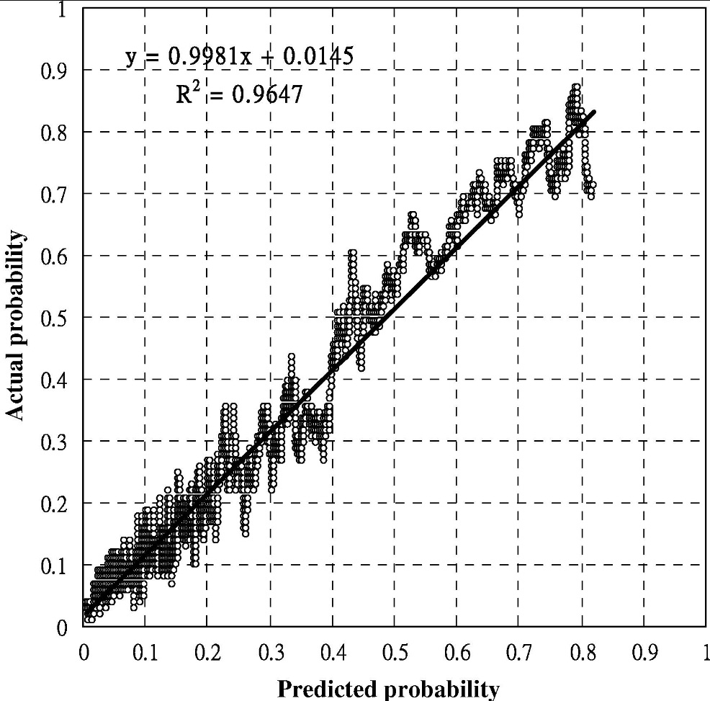
Yeh, & Lien, C. (2009). The comparisons of data mining techniques for the predictive accuracy of probability of default of credit card clients. Expert Systems with Applications, 36(2), 2473–2480. https://doi.org/10.1016/j.eswa.2007.12.020

Slide 26
THANK YOU!!!
Guanghong Yi
Guanghong.yi@uconn.edu

